Slide 1
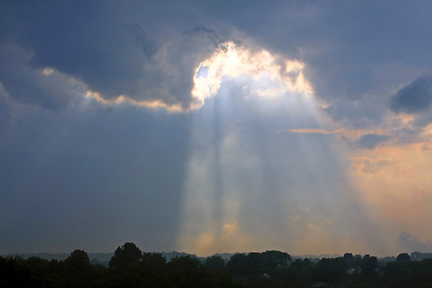
Immorality
Immorality
Karina Aguilera
Sabreena Singh
Priti Prasad
Sabreena Singh
Karina Aguilera
Priti Prasad

Slide 2
Immortality
Main Knowledge Question: Perception
- Linking question: Religion
Knowledge Question: Emotion
-Linking question: Art
Knowledge Question: Reason
- Linking question: Human Science(Psychology)

Slide 3
Overview
Immorality Definition:
Unethical quality, character, conduct
Wickedness ; Evilness

Slide 4
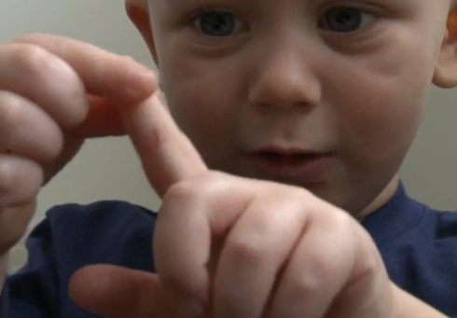
Madden Jenks

Slide 5
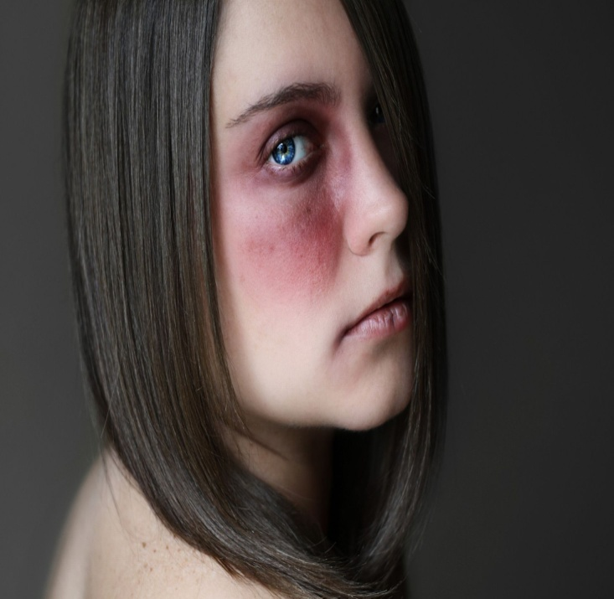
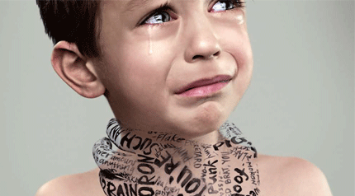
Main Knowledge Question:
How does our view of the world influence what we consider to be cruel?

Slide 6
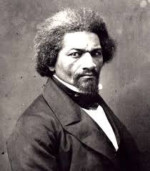
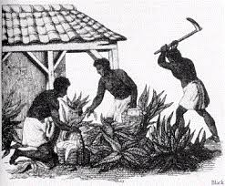
Perception Claim:
Common Sense Realism

Slide 7
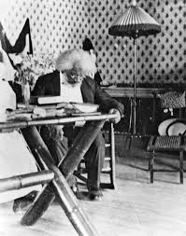
Perception Claim:
Prison of Consistency

Slide 8
Linking Question: Religion
What is the role of religion in determining
what is moral and what is immoral?

Slide 9
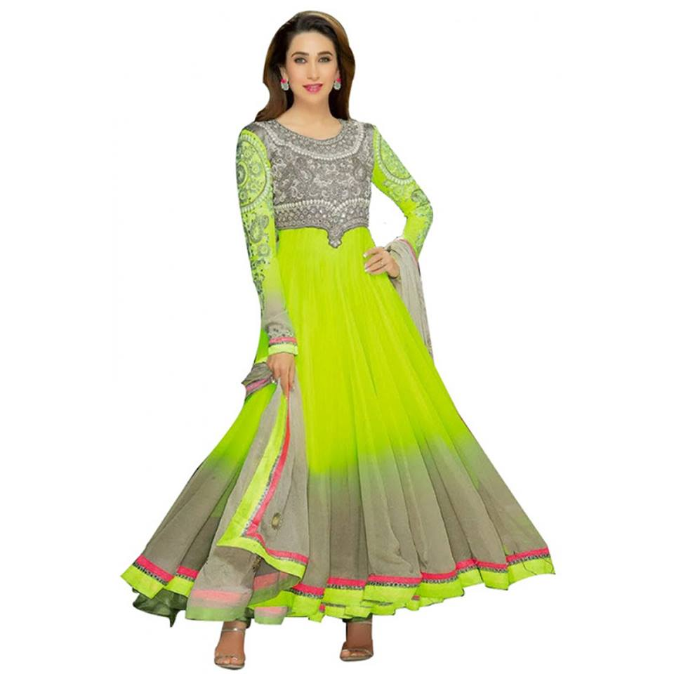
Claim:
Free-Will Defense

Slide 10
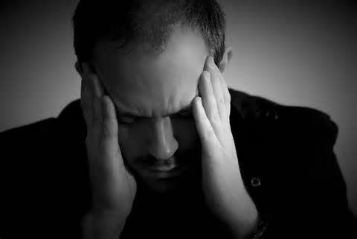
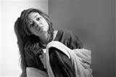
Knowledge Question:
How can emotion affect our decisions?

Slide 11
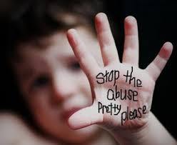
Emotion Claim:
Social-Specific Intuition

Slide 12
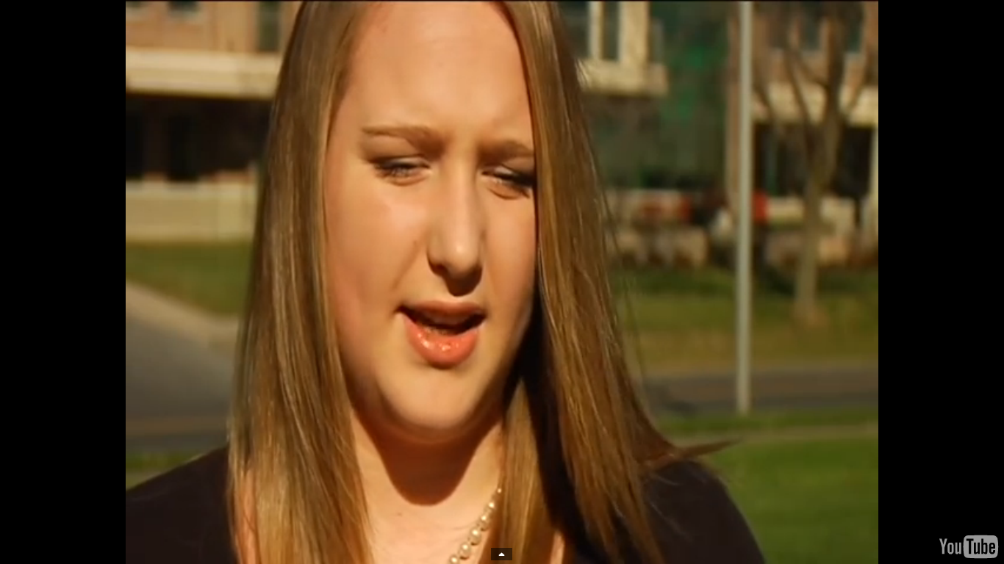
Emotion Claim:
Emotional Coloring
Brooke Bliss

Slide 13
Linking Question: Art
How is cruelty portrayed in various art
forms and what is its impact on society?

Slide 14
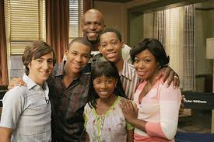
Claim:
The James-Lange Theory
TV Show Everybody Hates Chris

Slide 15
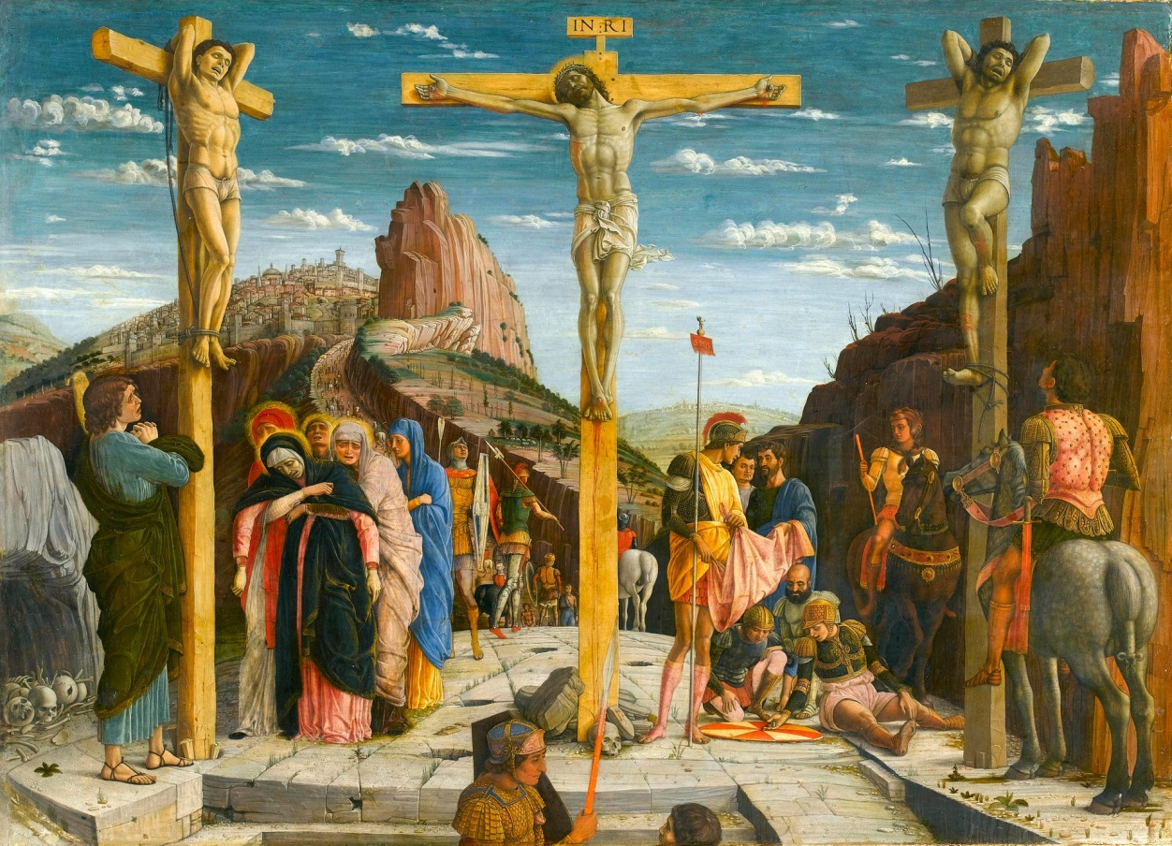
Claim:
The James-Lange Theory
Execution- Jesus Hangs on the Cross by Andrea Mantegna

Slide 16
Knowledge Question:
How can reason play a role in shaping our actions?

Slide 17
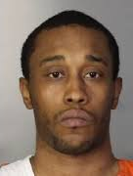
Reason Claim:
Moral Relativism
Michael Corsey

Slide 18
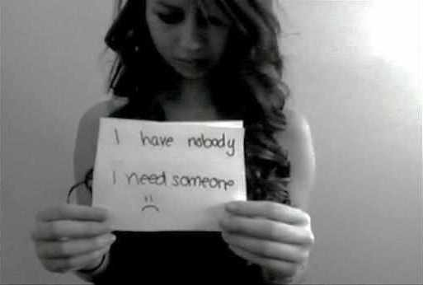
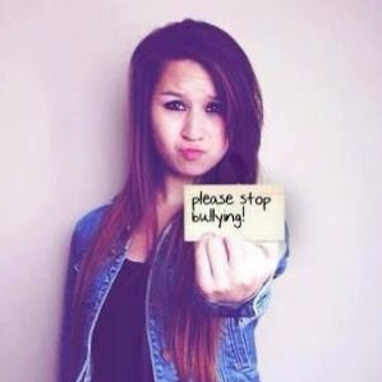
Reason Claim:
Moral Principle

Slide 19
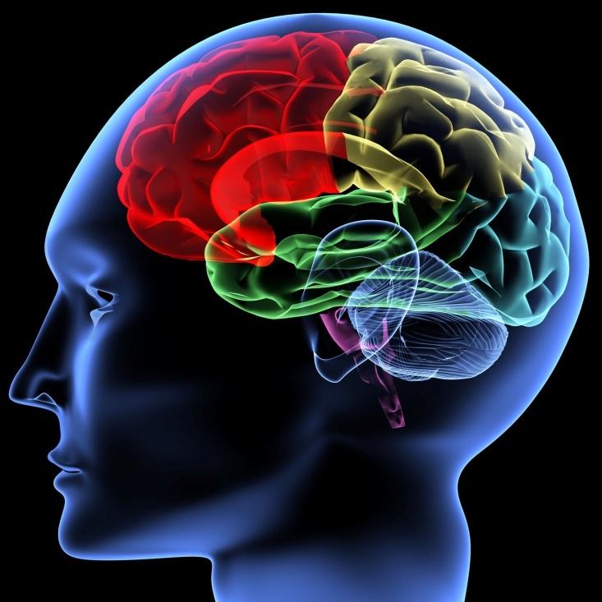
Linking Question: Human Sciences
What is the psychological effect of aggression on the perpetrator and the victim?

Slide 20
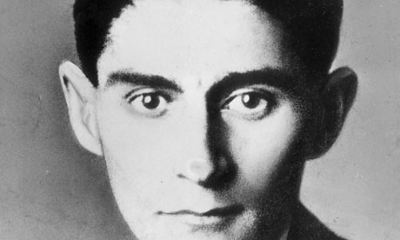
Claim:
Art as Education
Franz Kafka

Slide 21
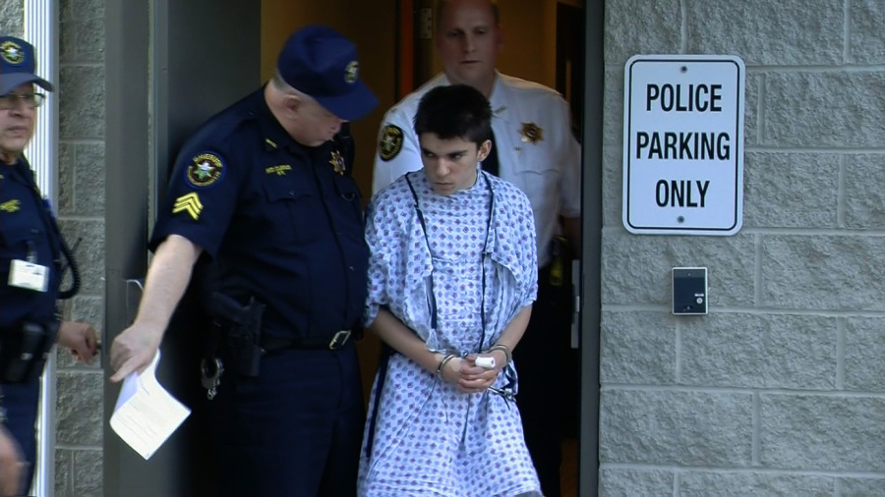
Claim:
Art as Education

Slide 22
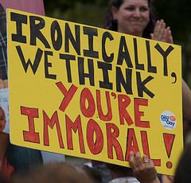
Conclusion:
We believe that immorality exists within all of us, however social norms prevent us from presenting it.
Everyone’s perception varies, so cruelty is viewed differently.

Slide 23
Work Cited:
"Immorality." Dictionary.com. Dictionary.com, n.d. Web. 23 Apr. 2014.
Lagemaat, Richard Van De. Theory of Knowledge for the IB Diploma. Cambridge: Cambridge UP, 2005. Print.
Grenoble, Ryan. "Amanda Todd: Bullied Canadian Teen Commits Suicide After Prolonged Battle Online And In School." The Huffington Post. TheHuffingtonPost.com, 11 Oct. 2012. Web. 20 Apr. 2014.
"Teen Speaks out after Verbal, Physical Bullying at School." CNY Central. N.p., n.d. Web. 23 Apr. 2014.
PBS. PBS, n.d. Web. 20 Apr. 2014.
"Toddler Cut by Razor Blade Glued to Monkey Bars at Illinois Playground."KDVRcom. N.p., n.d. Web. 23 Apr. 2014.

Slide 24
Work Cited:
McCormack, Simon. "Woman Stabbed For Bringing Boyfriend Wrong Lunch: Cops." The Huffington Post. TheHuffingtonPost.com, 12 Jan. 2014. Web. 23 Apr. 2014
. "Frederick Douglass." Frederick Douglass. N.p., n.d. Web. 22 Apr. 2014.
"Two-knife Stabbing Rampage at Pennsylvania High School Injures 22, Suspect in Custody." NY Daily News. N.p., n.d. Web. 24 Apr. 2014.
Snodgrass, Mary Ellen. The Metamorphosis: Franz Kafka. Jacksonville, IL: Perma-Bound, 1989. Print.
McCormack, Simon. "Woman Stabbed For Bringing Boyfriend Wrong Lunch: Cops." The Huffington Post. TheHuffingtonPost.com, 12 Jan. 2014. Web. 23 Apr. 2014.

