Slide 1
Madness
By: Kajol Sharma & Julia Vang

Slide 2
Overview
Does madness exist?
Knowledge Issue: Perception
- Linking question: Culture
Knowledge Issue: Emotion
-Linking question: Art & Ethics
Knowledge Issue: Reason
- Linking question: History

Slide 3
Madness
line between insanity and sanity is man-made
purely based on human perception.

Slide 4
Madness
Sandy Hook massacre

Slide 5
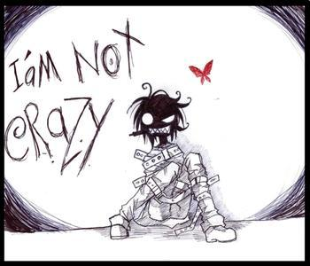
Knowledge Issue: Perception
How can perception affect our view of what is “reality”?

Slide 6
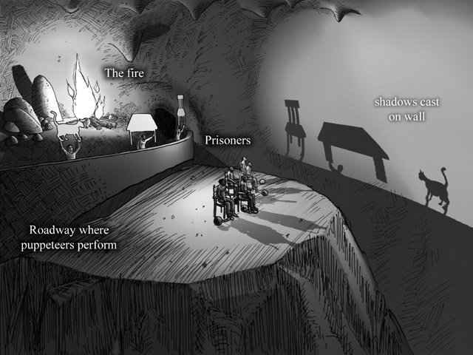
Perception: Claim
Plato’s Allegory of the Cave

Slide 7
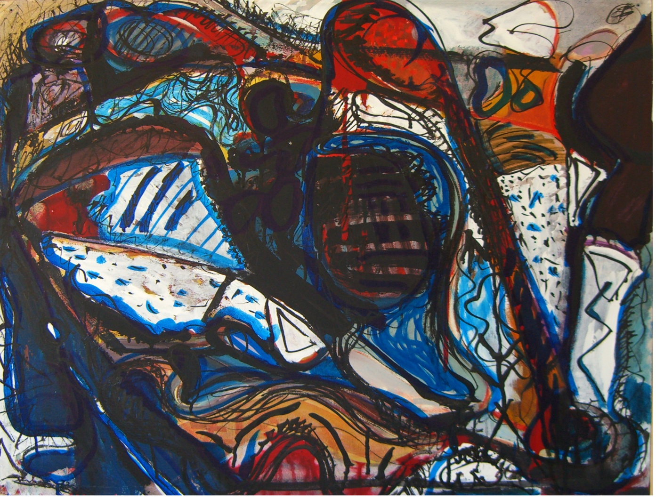
Perception: Claim
Common-sense Realism

Slide 8
Linking Question: Culture
How is mental illness viewed culturally?

Slide 9
Linking Question: Culture
How is mental illness viewed culturally?

Slide 10
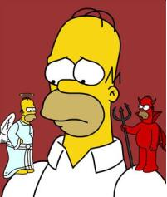
Knowledge Issue: Emotion
How can emotion determine our vices and virtues?

Slide 11
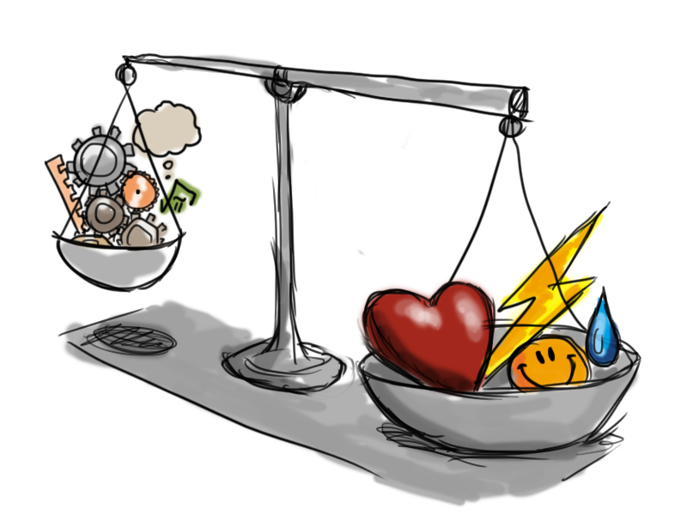
Emotion: Claim
Emotions and Rationality or Irrationality

Slide 12
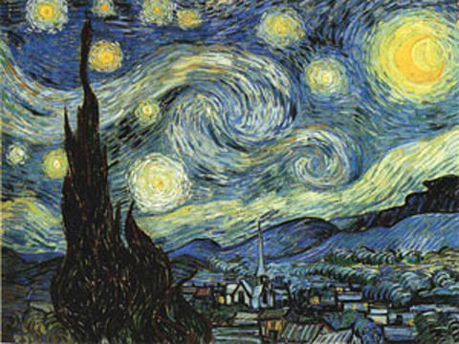
Linking Question: Ethics & Art
What is the role of mental illnesses in the creation of art?

Slide 13
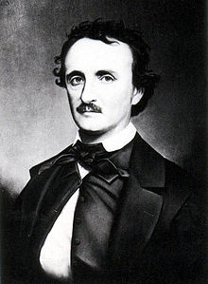
Linking Question: Ethics & Art
“I became insane, with long intervals of horrible sanity.” -Edgar Allen Poe

Slide 14
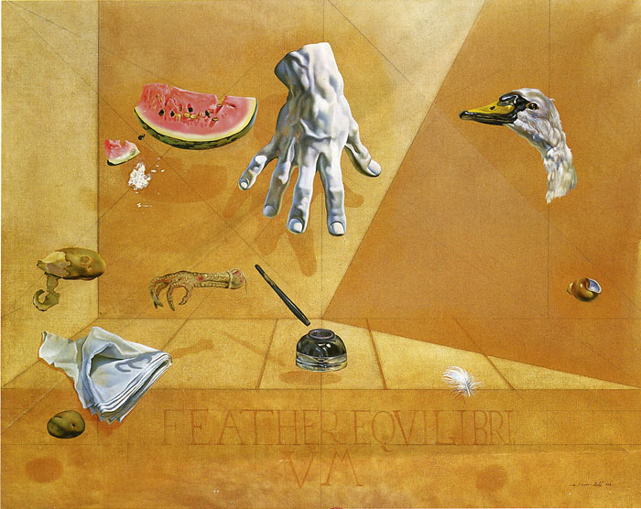
Linking Question: Ethics & Art
The Dali murder mystery

Slide 15
The Insanity Test Results

Slide 16
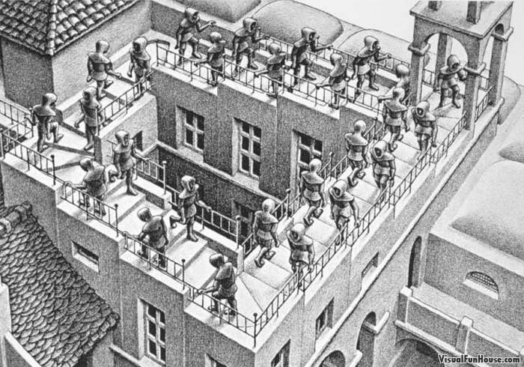
Knowledge Issue: Reason
How can reason be an entrapment (due to a prison of consistency)?

Slide 17
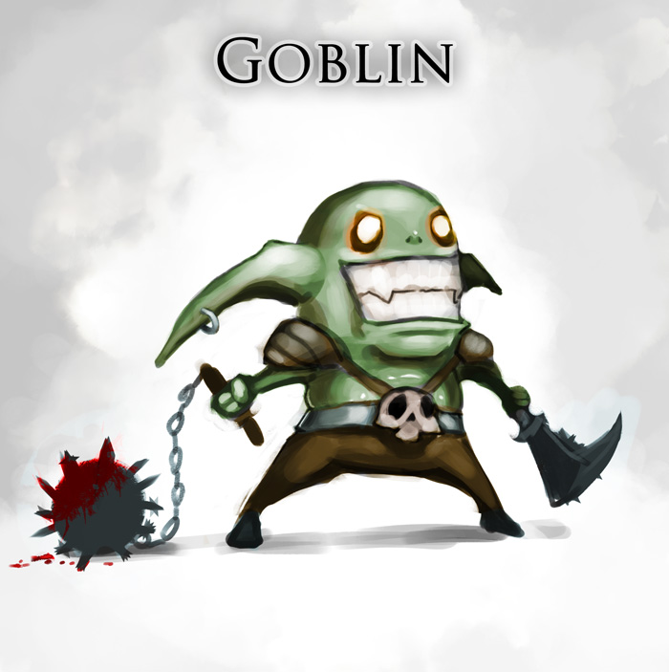
Reason: Claim
“A foolish consistency is the hobgoblin of little minds.” - Ralph Waldo Emerson

Slide 18
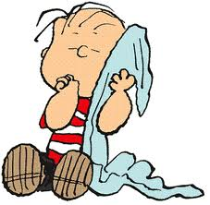
Reason: Claim
Consistency can also be a veil of protection and comfort for humans.

Slide 19
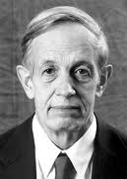
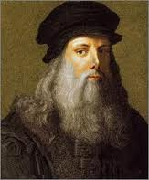
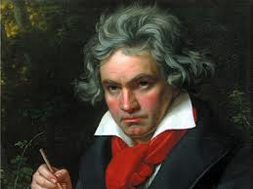
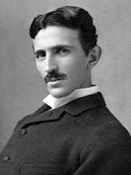
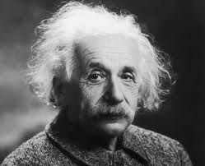
Linking Question: History
How has mental illness been viewed historically?

Slide 20
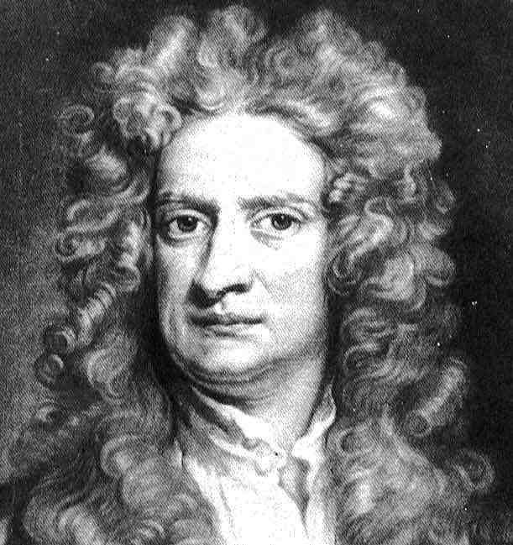
Linking Question: History
Isaac Newton

Slide 21
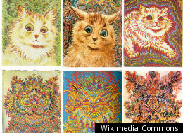
Linking Question: History
Isaac Newton

Slide 22
Linking Question: History
“Science has not yet taught us if madness is or is not the sublimity of the intelligence.” -Edgar Allan Poe

Slide 23
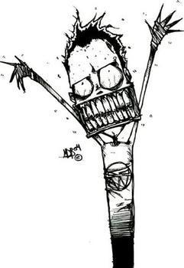
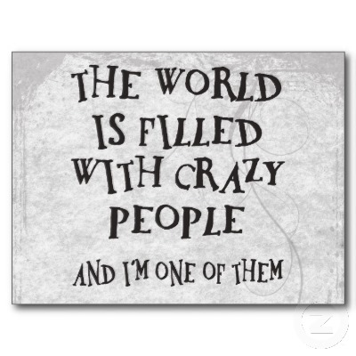
Conclusion
We believe that insanity and sanity is a man-made theory to limit the originality of people.

Slide 24
Citations
"Newton, Sir Isaac." Encyclopedia Britannica. 2008. Encyclopedia Britannica Online
Stamp Out Stigma. "Famous People with Mental Illness." (Mar. 4, 2008) http://www.stampoutstigma.org/famous.html­
"Allegory of the Cave." Allegory of the Cave. N.p., n.d. Web. 07 Mar. 2013. <http://faculty.washington.edu/smcohen/320/cave.htm>.
Emerson, Ralph. "Self-Reliance." Self-Reliance. N.p., n.d. Web. 07 Mar. 2013. <http://www.emersoncentral.com/selfreliance.htm>.
"Ellis' Irrational Beliefs." Ellis' Irrational Beliefs. N.p., n.d. Web. 07 Mar. 2013. <http://changingminds.org/explanations/belief/irrational_beliefs.ht m>.
NIHILISM by Eugene Rose. Rep. N.p., n.d. Web. 07 Mar. 2013. <http://www.columbia.edu/cu/augustine/arch/nihilism.html>.

